Slide 1
PHY 101-GENERAL PHYSICS I
LECTURE – PART A

Slide 2
OUTLINE
Space and Time: Units and dimension
Vector and scalar:
differentiation of vectors: displacement, velocity and acceleration
Kinematics: Newton’s law of motion
Relative motion
Applications of Newtonian mechanics
Equation of MOTION
Conservation principles in physics: conservative forces, conservation of linear momentum, kinetic energy and work, potential energy

Slide 3
Space and time- units and dimension
In Physics any quantity that has a measurable property is known as a physical quantity.
Physical quantity can be classified into two: fundamental and derived quantity.

Slide 4
Fundamental quantities and units
Fundamental quantities are independent quantities or that do not depend on any other quantities for their derivations and their units are called fundamental units. Examples are
Quantity | Unit | Symbol
Time | seconds | S
Mass | kilogram | Kg
Length | metre | M
Temperature | kelvin | K
Electric current | Ampere | A
Amount of substance | Mole | Mol
Luminous Intensity | Candela | Cd

Slide 5
Derived quantities and units
Derived quantities are those quantities that derived from the fundamental quantities. Their units are known as derived units. Examples are:
Quantity | Formula | Unit | Symbol
Area | Length x length | Metre squared | m²
Volume | Length x length x length | Metre cubed | m³
Speed | Distance/Time | Metre per second | m/s or ms⁻¹
Velocity | Displacement/Time | Metre per second | m/s or ms⁻¹
Acceleration | Velocity/Time | Metre per second squared | m/s² or ms⁻²
Force | Mass x acceleration | Newton | N
Work | Force x Distance | Newton-metre or Joule | Nm or J
Density | Mass/Volume | Kilogram per metre cubed | Kgm⁻³
Pressure | Force/Area | Newton per metre squared | Nm⁻²
Momentum | Mass x velocity | Kilogram-metre per second | Kgms⁻¹

Slide 6
dimensions
Dimensions are the powers to which fundamental quantities are raised to represent a particular quantity.
Physical Quantity | Dimensional Formula
Area | [L²]
Volume | [L³]
Velocity | [LT⁻¹]
Acceleration | [LT⁻²]
Force | [MLT⁻²]
Work | [ML²T⁻²]
Momentum | [MLT⁻¹]

Slide 7
Uses of dimensions
To determine the true relationship between physical quantities
Helps to determine the appropriate unit of a physical quantity
To check the accuracy of physical quantities.

Slide 8
examples
What is the dimension of pressure
Pressure = force/area, p = f/a
But f = [MLT⁻²], a = [L²]
p =

Slide 9
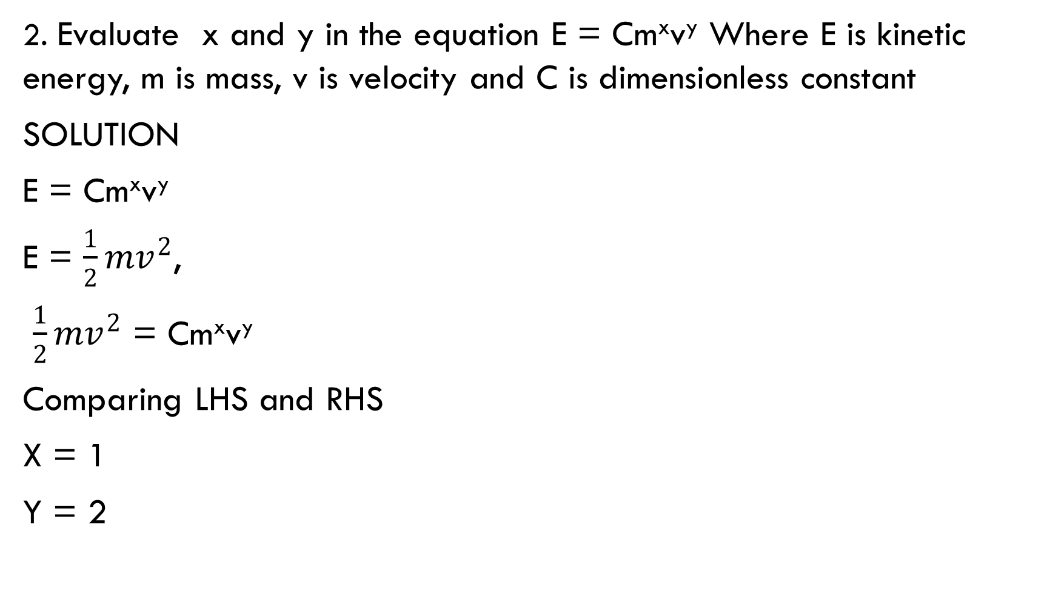

Slide 10
Vectors and scalar
Scalar is a quantity with magnitude but no direction. E.g. distance, time, temperature, area, volume, electric current, energy, speed e.t.c.
Vector is a quantity with both magnitude and direction. E.g displacement, force, velocity, acceleration, momentum etc.

Slide 11
Vector representation
Vectors can be represented in the following ways.
A
A

Slide 12
Vector resolution
Vectors can be resolved into: vertical and horizontal components

Slide 13
Horizontal component
Where A is the magnitude of the vector
Horizontal component
Vertical component

Slide 14
The resultant vector
FOR 2-D
The magnitude of vector A is given as:
We can write for 2-D
For 3-D
Magnitude of A
A can be resolved as
Where i, j, and k are unit vectors in the x, y and z directions

Slide 15
Vector direction
In 2-D, the angle that vector A makes with the positive x-axis is given as:

Slide 16
Unit vector
A unit vector is a vector having a unit magnitude. It is used to describe the direction of the vector. It is given as:
=
but
Therefore
Where are called direction cosines of vector A

Slide 17
Let’s take a look at the problem below

Slide 18
Vector addition
The process in which to or more vectors are added to get a single vector is called vector addition. This single vector is known as resultant vector. It has the same effect as the other vectors combined together.
Vectors can be added graphically by head to tail rule.
According this rule, addition of vector A and B can be done by
Placing the tail of B on the head of A
Drawing a line from the tail of A to the head of B. is line is the sum of vectors A and B called the resultant vector.

Slide 19
N.B: A + B and B + A have the same resultant.
We can write A + B = B + A
Therefore vector addition is cummutative

Slide 20
Vectors can also be added component-wisely
Two vectors A and B are give as A = 2i + 3j + 2k and B = i + 2j + 4k. Find the value of A +B
Solution
Given: A = 2i + 3j + 2k , B = i + 2j + 4k.
A +B = (2i + 3j + 2k )+ (i + 2j + 4k)
Adding i to i, j to j and k to k
= 2i +i + 3j + 2j +2k + 4k
= 3i + 5j + 6k
N.B: Addition of vector gives a vector

Slide 21
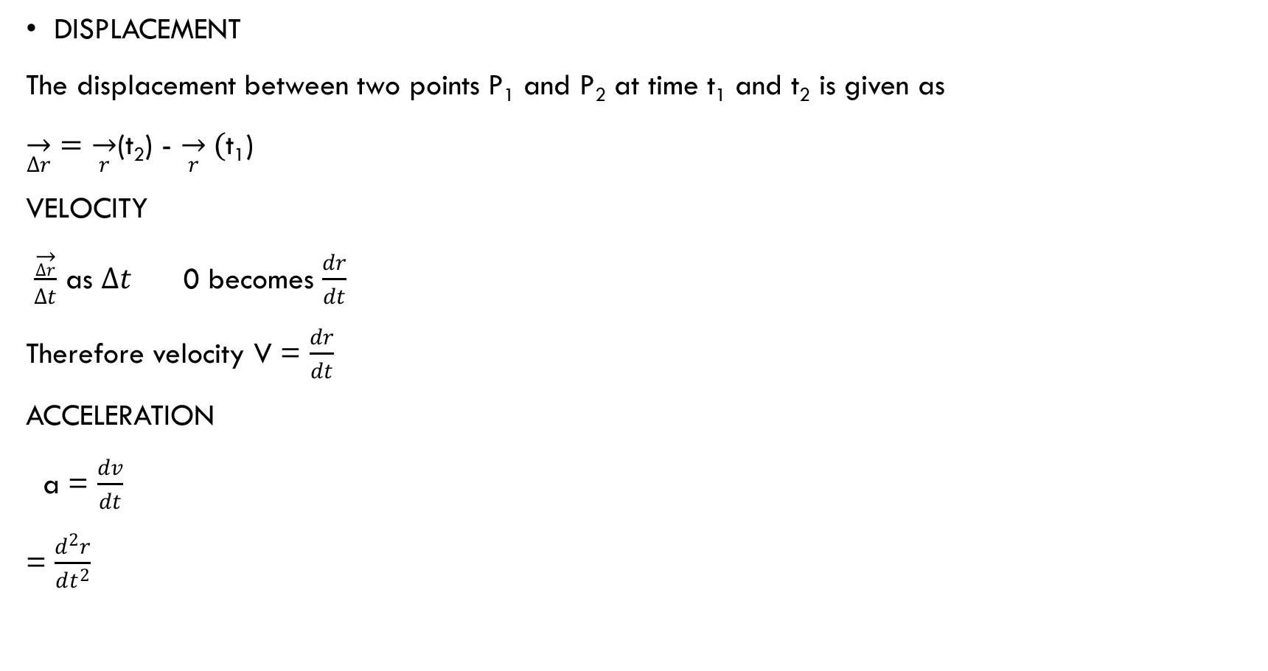
Vector differentiation

Slide 22
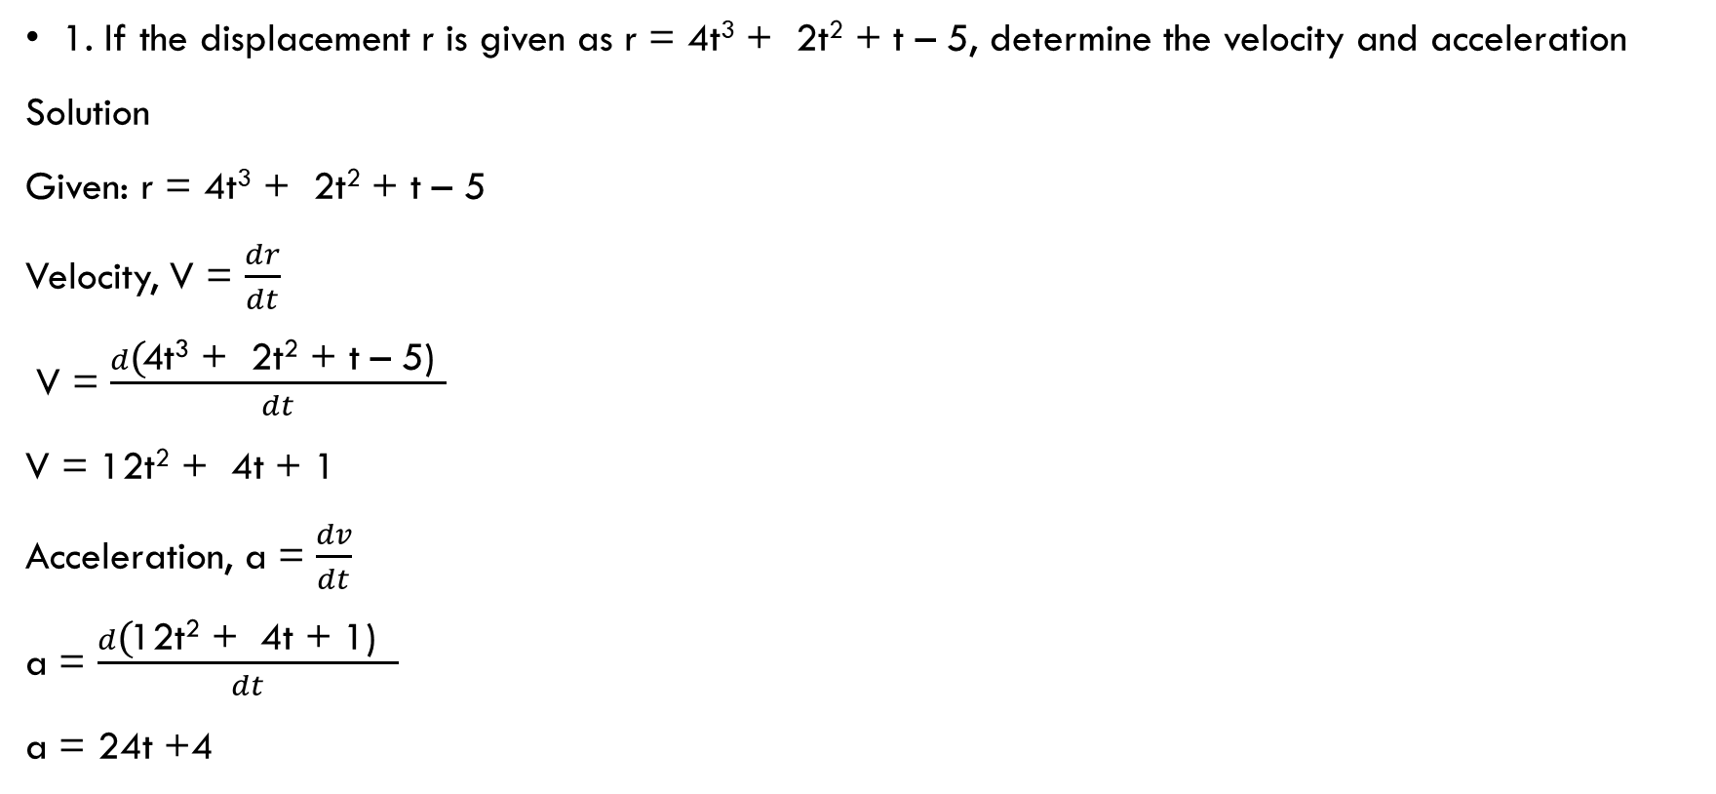
Example

Slide 23
kinematics
Kinematics: is the study of motion of a body without the consideration of its cause.
Motion is the change of a body position with time.
Motion can be: translational, oscillatory, random or rotational.

Slide 24
newton’s laws of motion
First law: A body continues to be in its state of rest or in uniform motion along a straight line unless an external force is applied to it. This law is know as the law of inertia.
INERTIA: this is the tendency of a body at rest to remain at rest and a body motion to continue moving with unchanged velocity. Inertia is a measure of mass of a body.
EXAMPLE : if a moving vehicle suddenly stops then the passengers inside the vehicle bend outward.

Slide 25
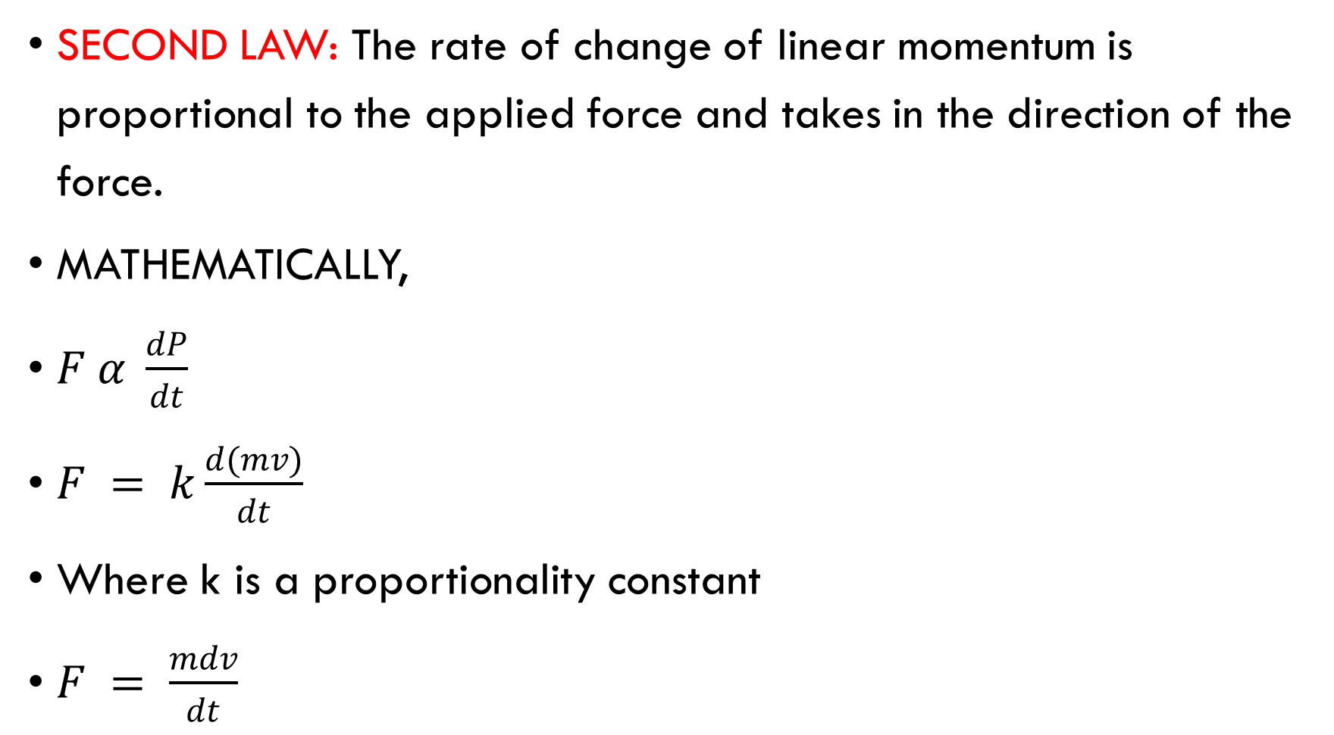

Slide 26
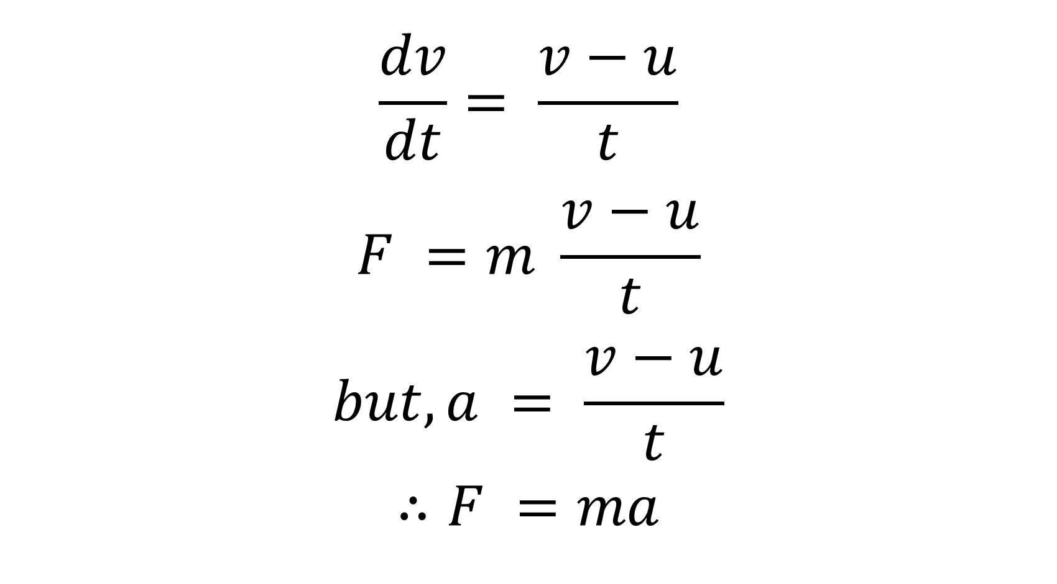

Slide 27
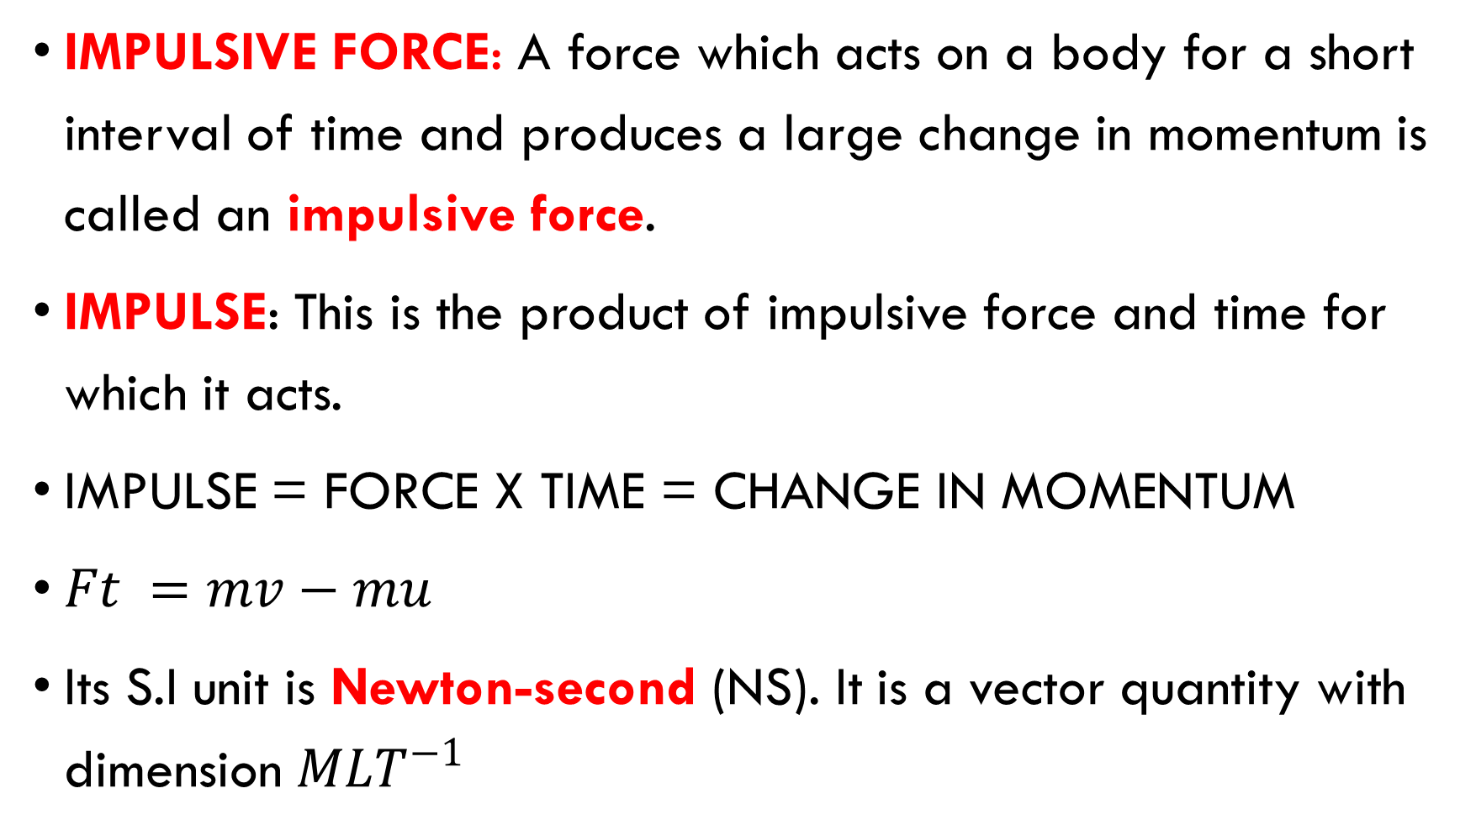

Slide 28
Third law: For every action there is an equal and opposite reaction.
Example: recoil of gun, jet propulsion.

Slide 29
Relative motion
Relative motion is the motion of a body with respect to another. The velocities of the bodies are relative to each other.
The relative velocity of object A with respect to object B is
V_{AB} = V_{A} – V_{B}
When two objects are moving in the same direction
V_{AB} = V_{A} – V_{B}
When two objects are moving in different direction
V_{AB} = V_{A} + V_{B}
When the two objects are moving at an angle to each other

Slide 30
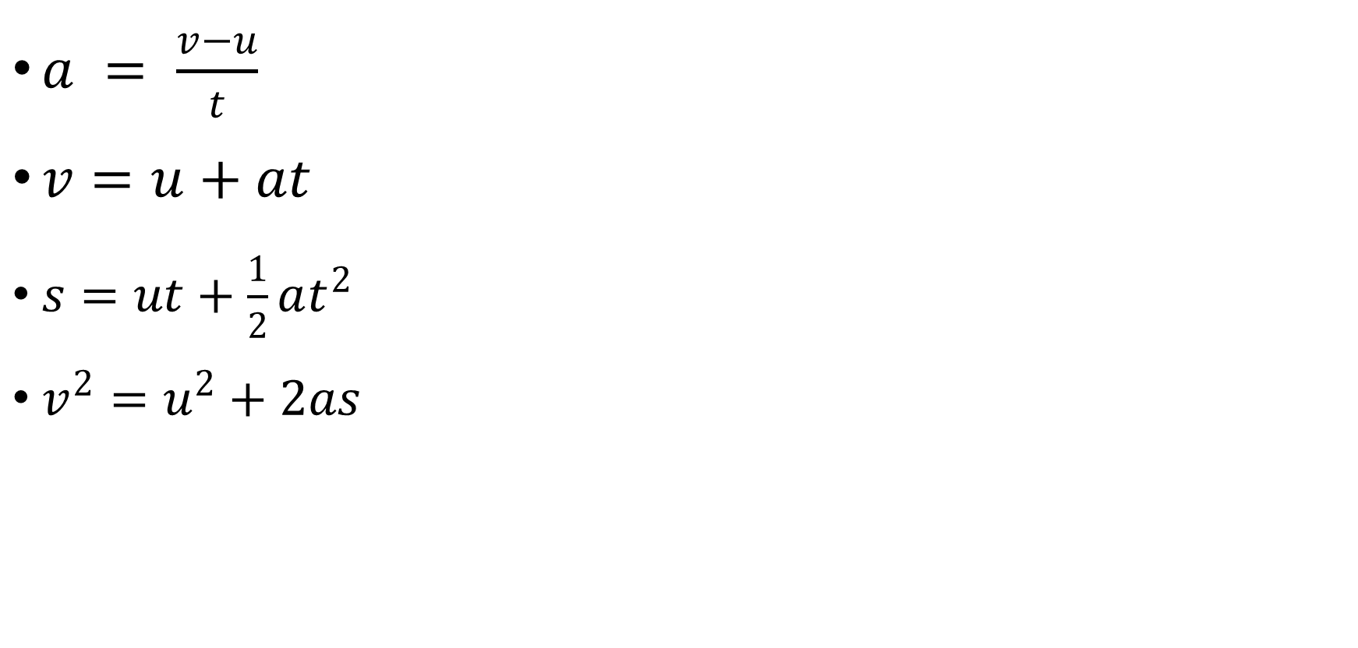
Application of Newtonian mechanics equations of motion

Slide 31
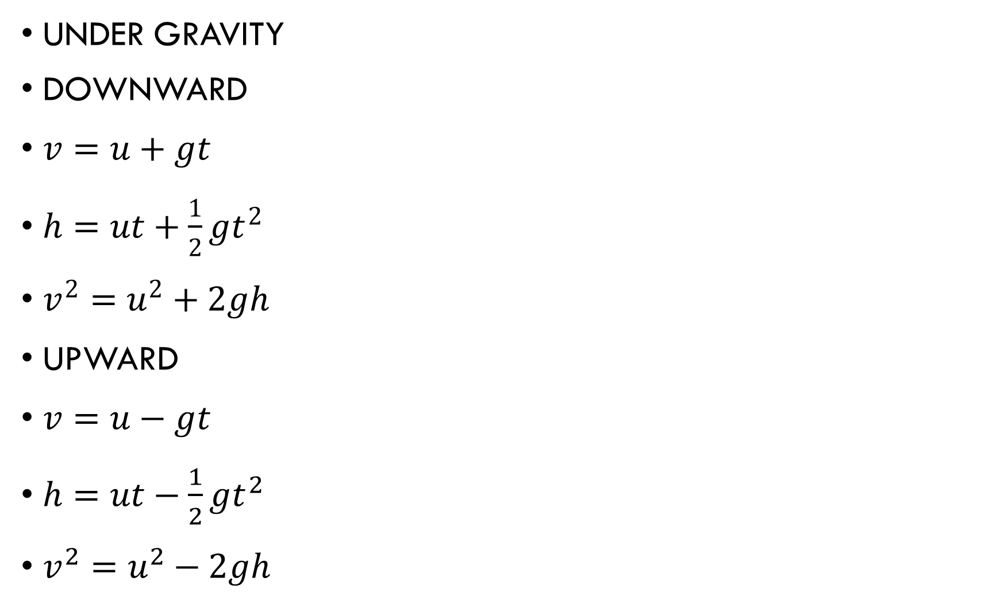

Slide 32
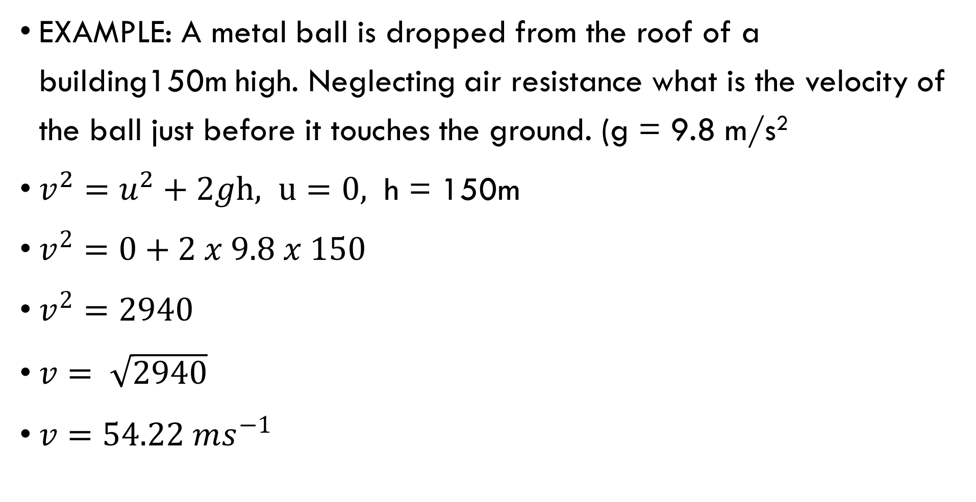

Slide 33
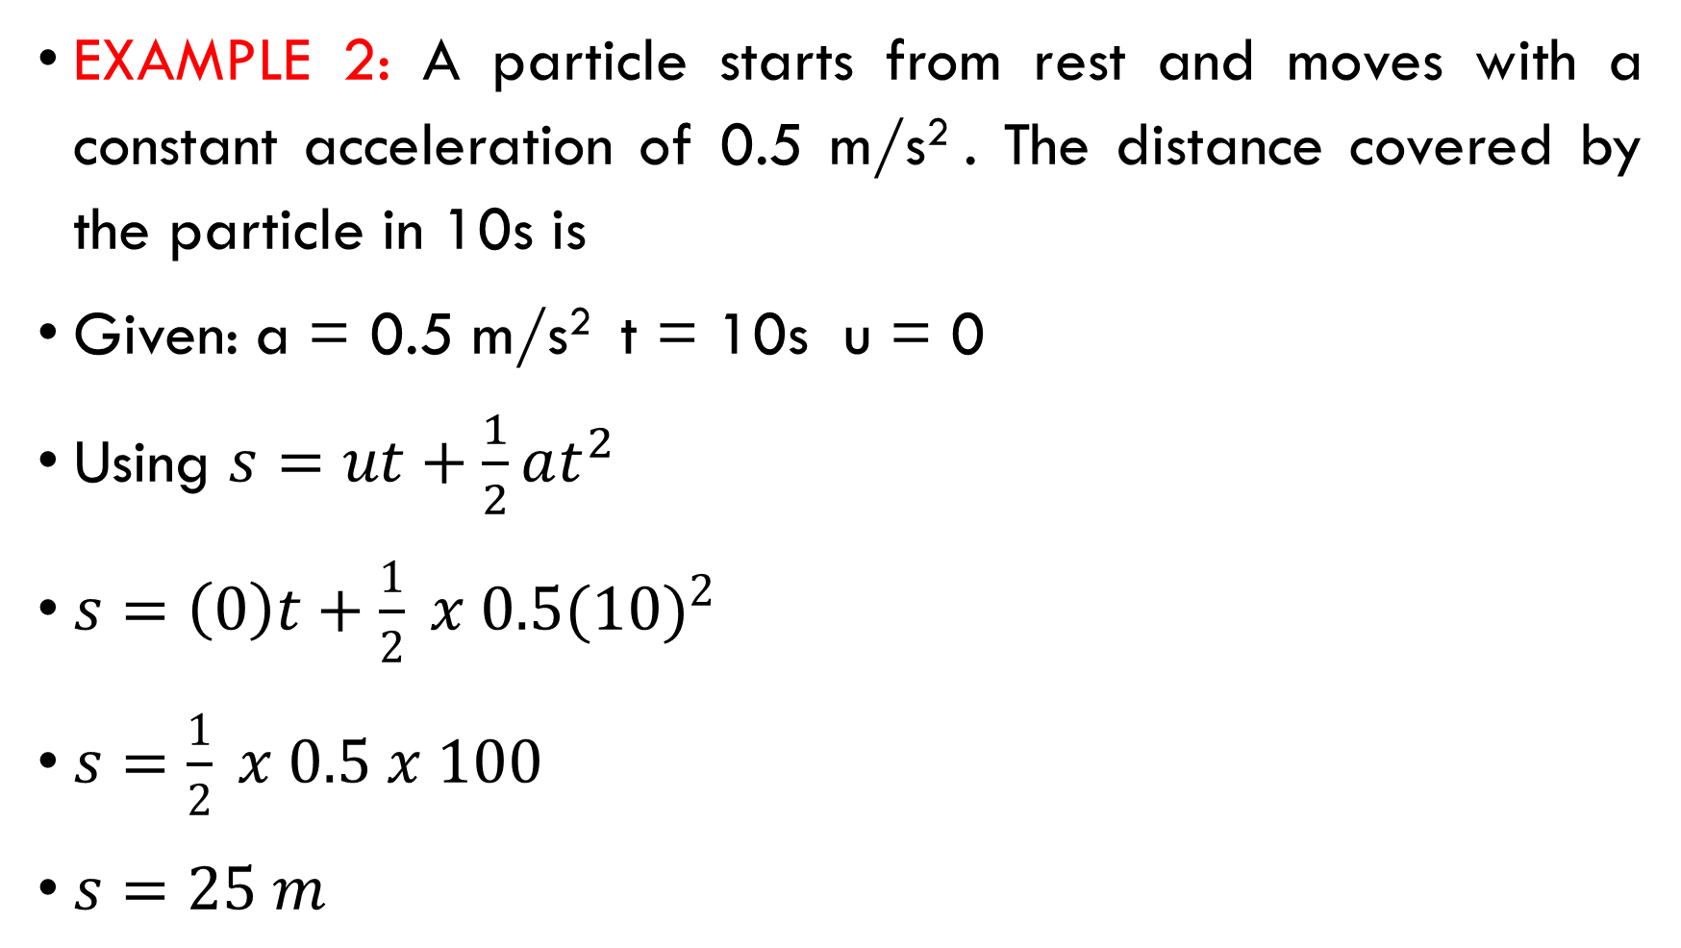

Slide 34
Velocity time graph
This is the graph of velocity against time. The slope of this graph gives the acceleration of the motion.
DIFFERENCE VELOCITY – TIME GRAPH
Object moving with constant velocity

Slide 35
2. Object accelerating uniformly from rest
3. Object moving with uniform retardation

Slide 36
Object moving with increasing acceleration
Object moving with decreasing acceleration

Slide 37
A car starts from rest at point A at Godfrey Okoye University main gate and comes to rest at point B at Godfrey Okoye University campus II gate 2km away in 3 minutes. It has first a uniform acceleration for 40s, then a uniform speed and is brought to rest with constant deceleration after 20s. (i) Represent the motion in a velocity time graph. (ii) determine the maximum speed (iii) find the deceleration.
Solution
(i)

Slide 38
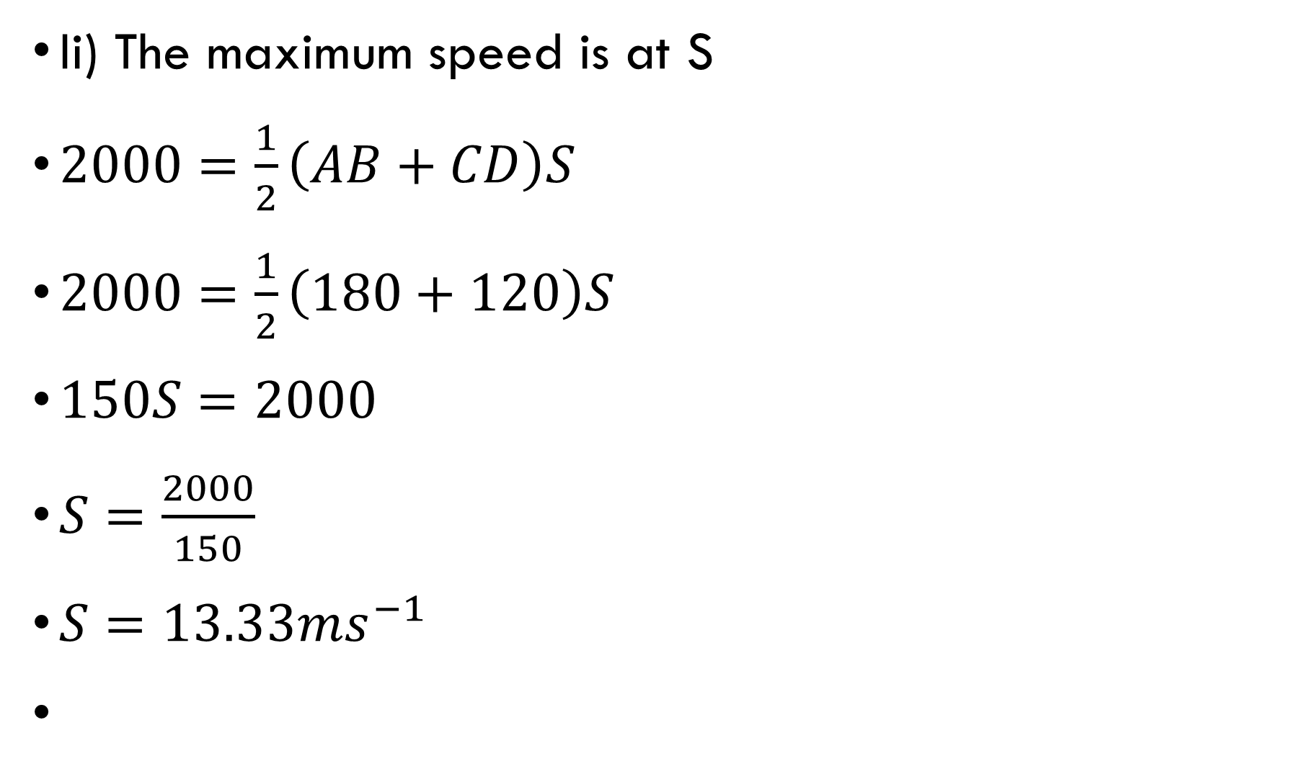

Slide 39
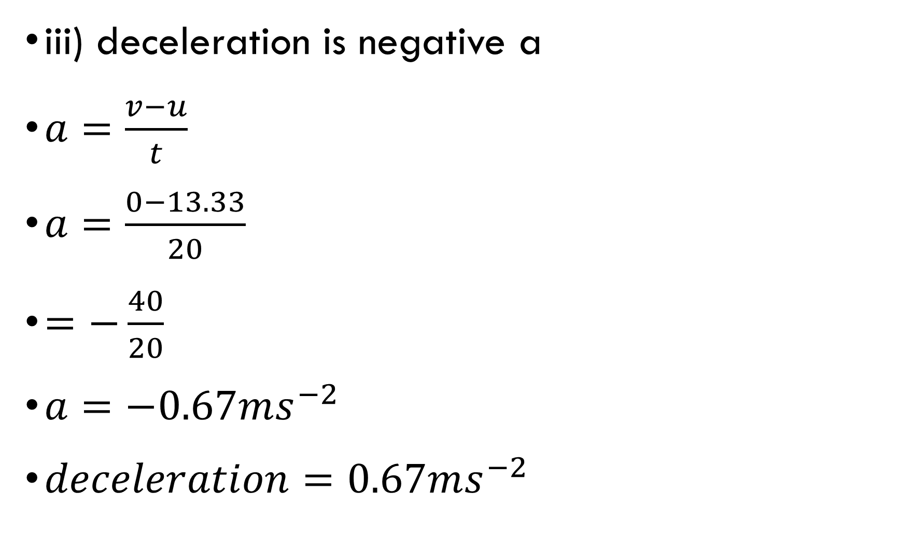

Slide 40
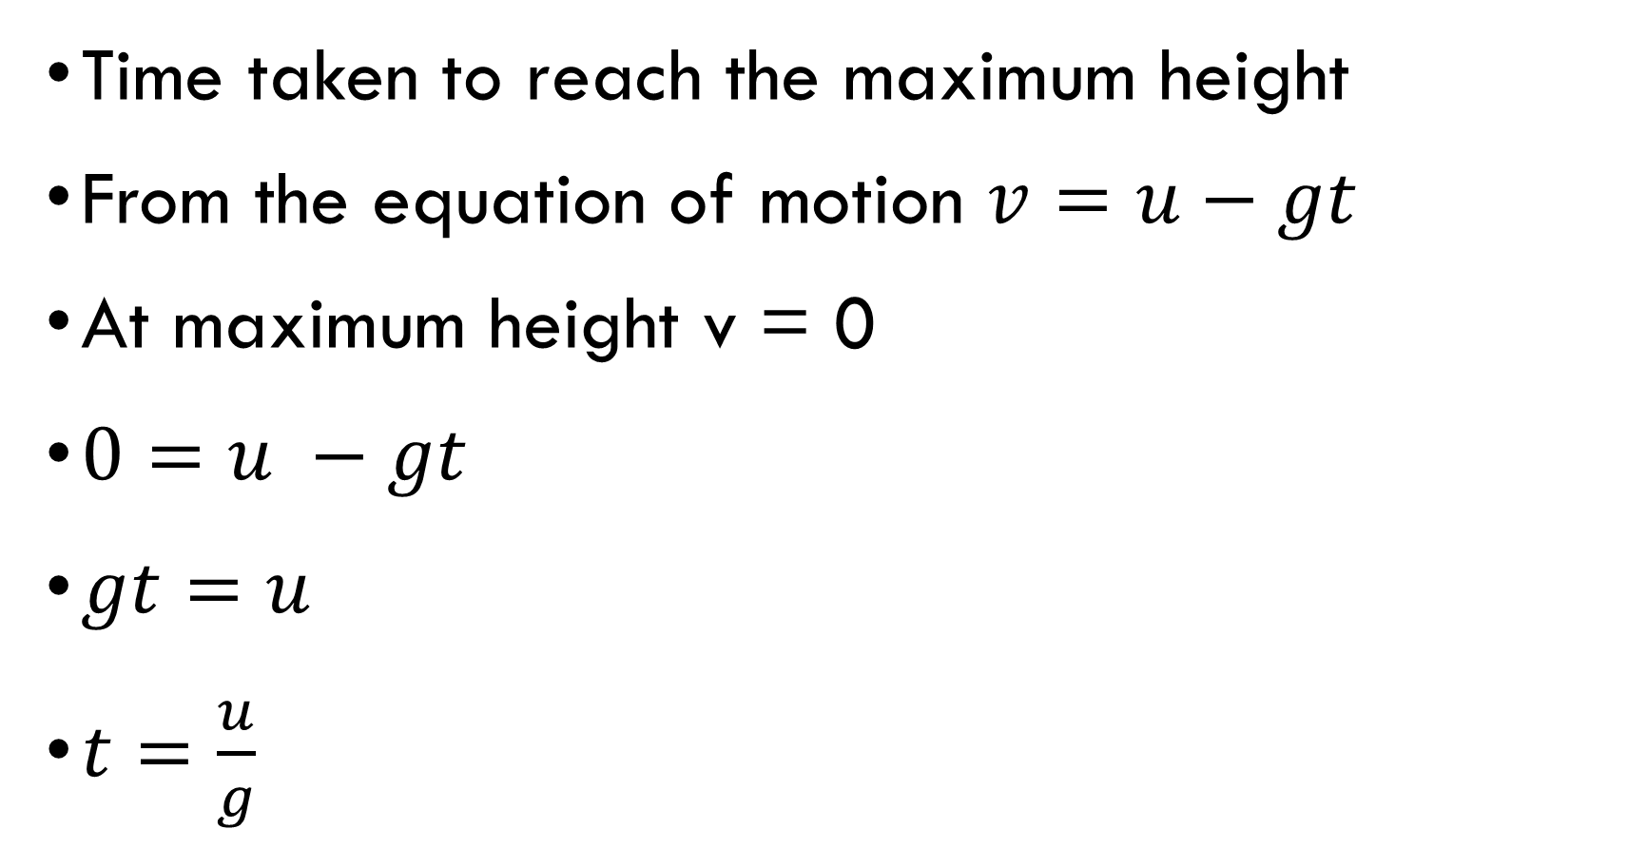

Slide 41
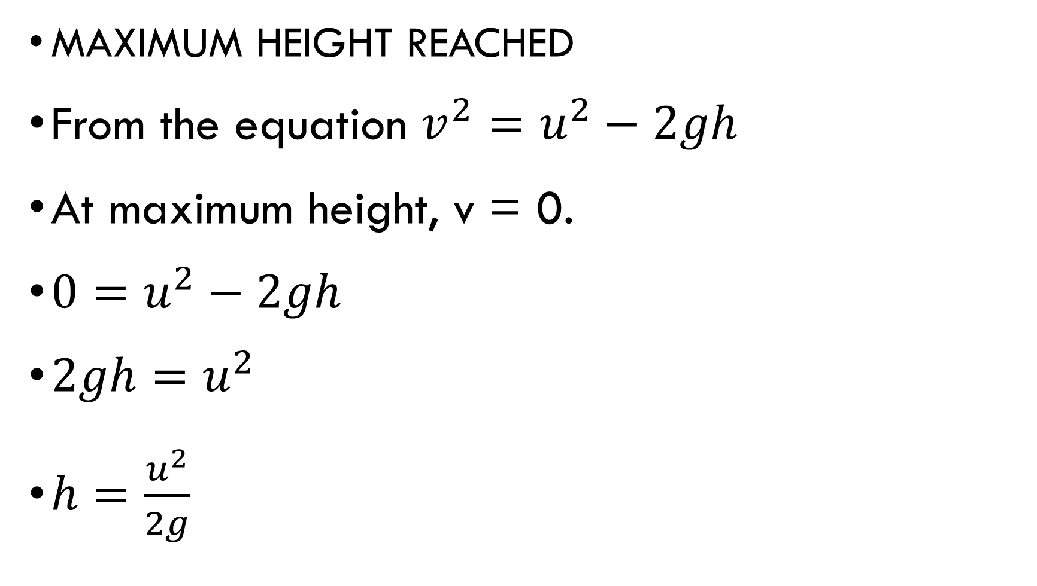

Slide 42
Motion in two or three dimension

Slide 43
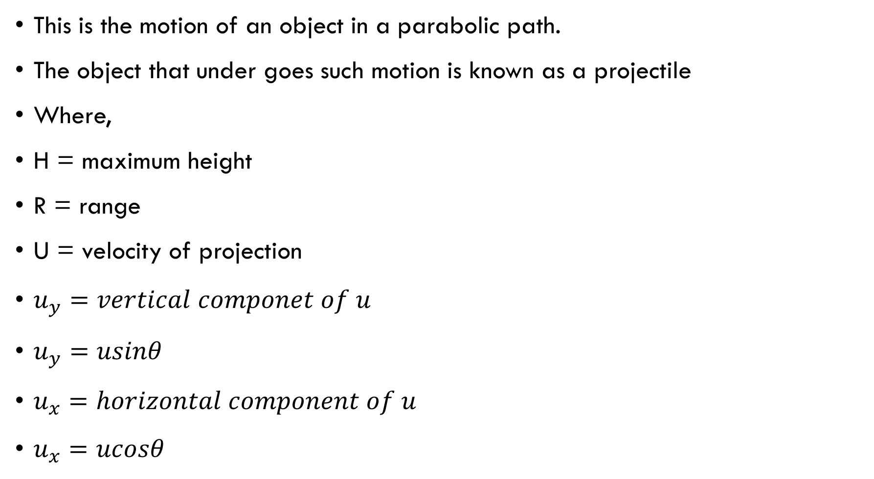
PROJECTILE MOTION

Slide 44
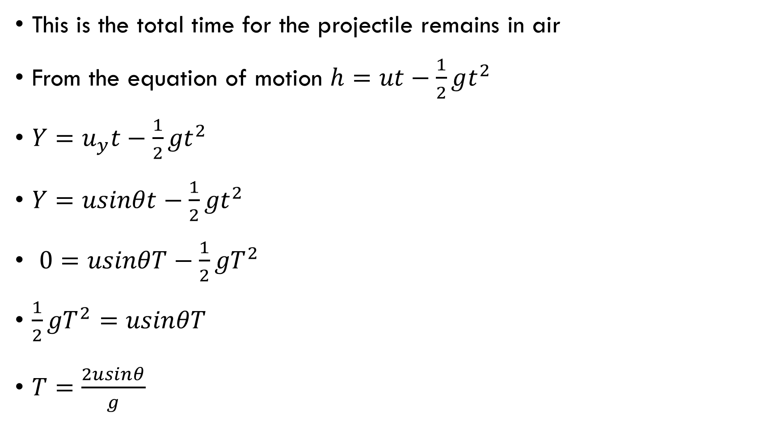
Time of flight

Slide 45
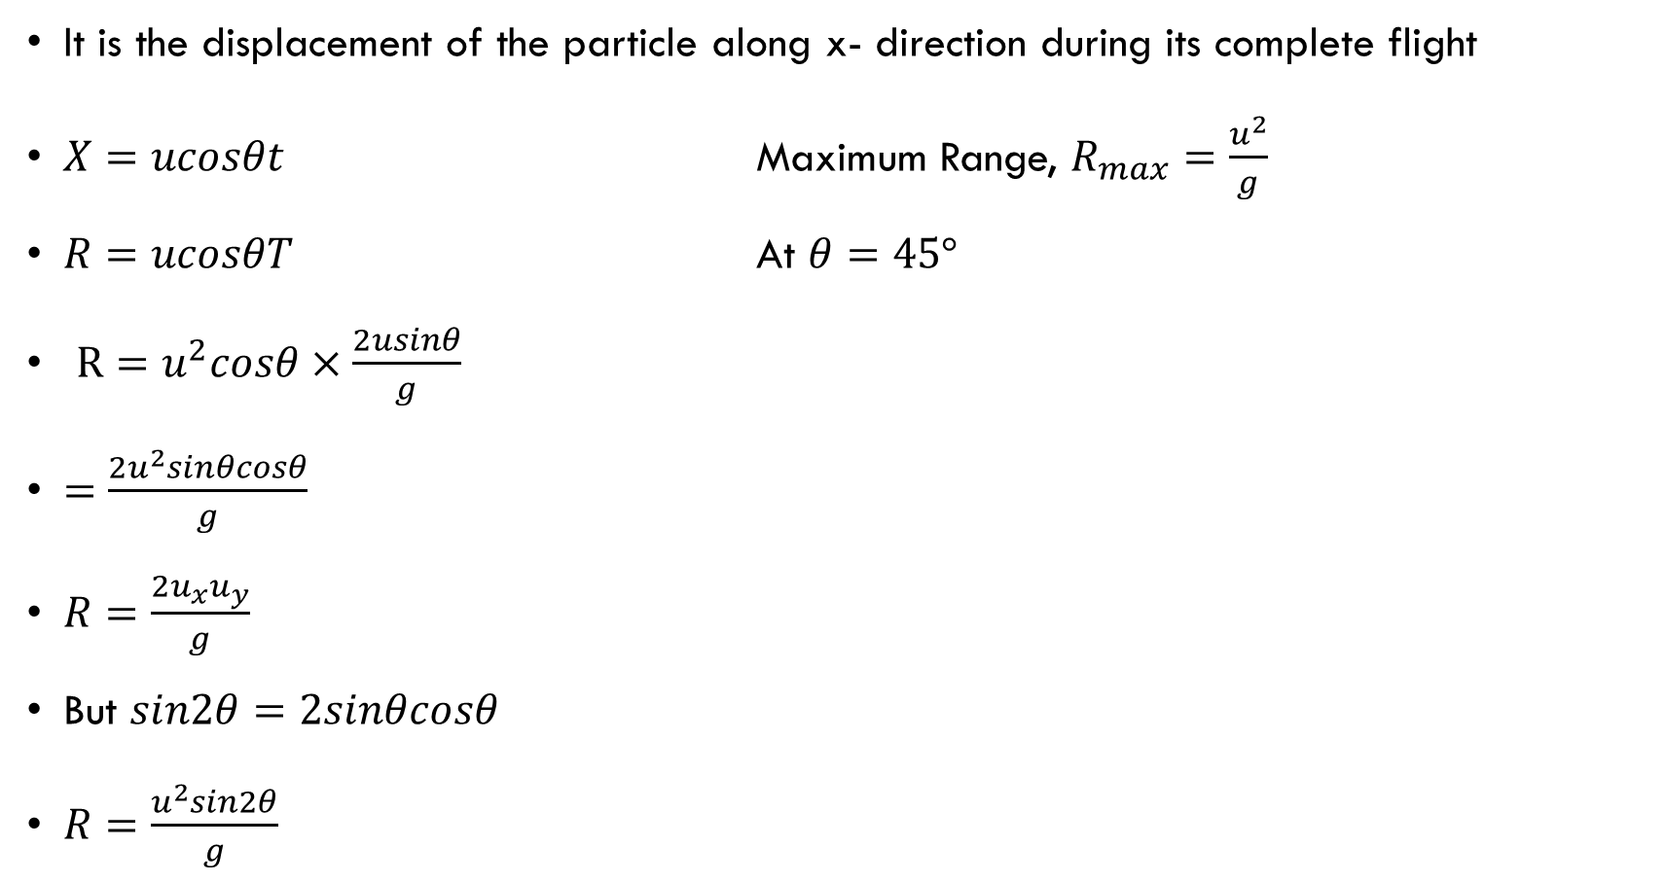
Horizontal range

Slide 46
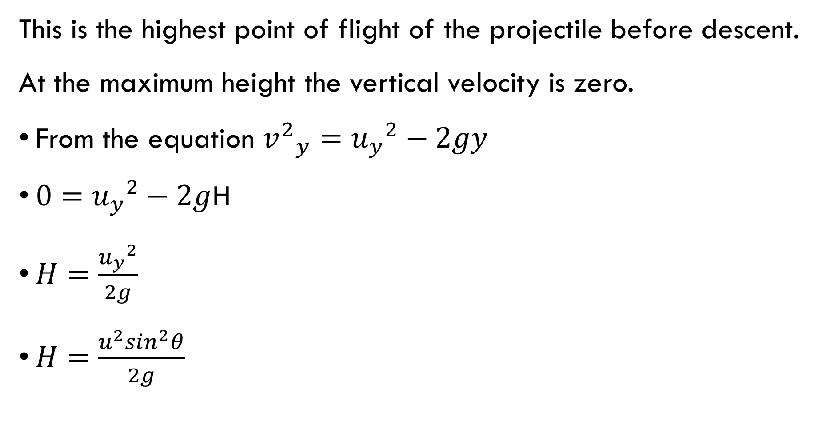
Maximum height

Slide 47
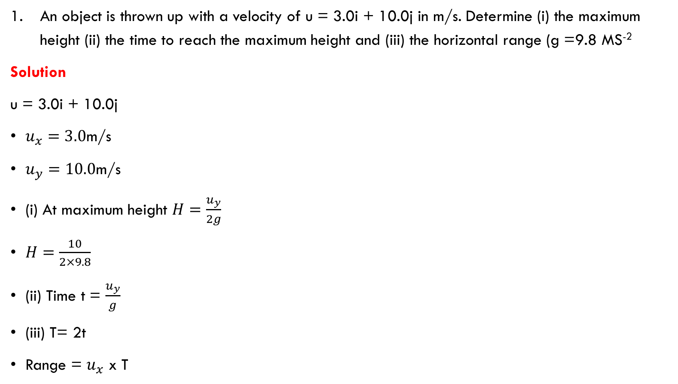
examples

Slide 48
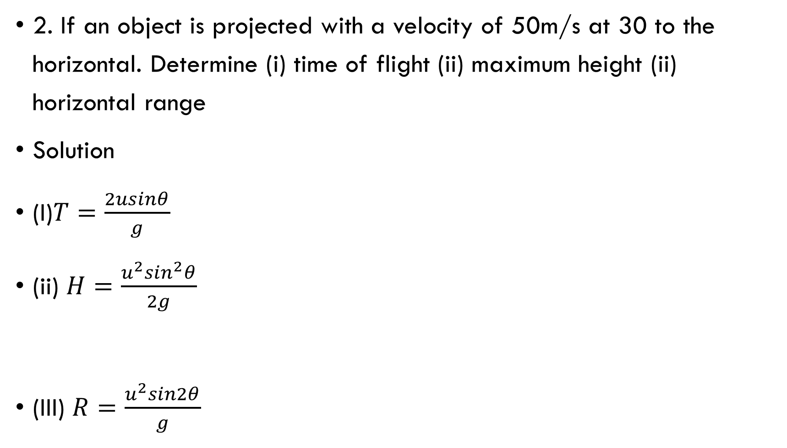

Slide 49
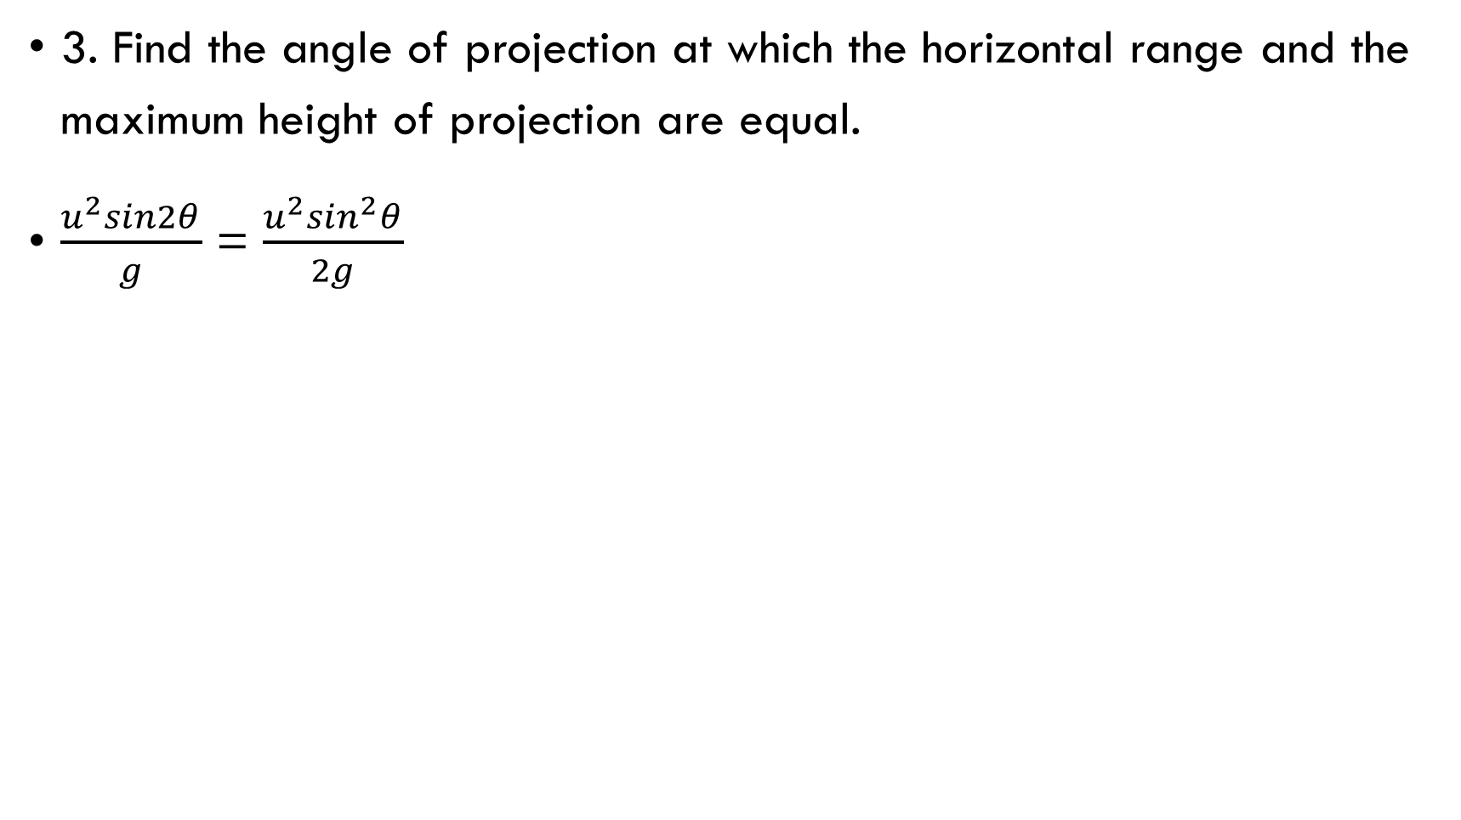

Slide 50
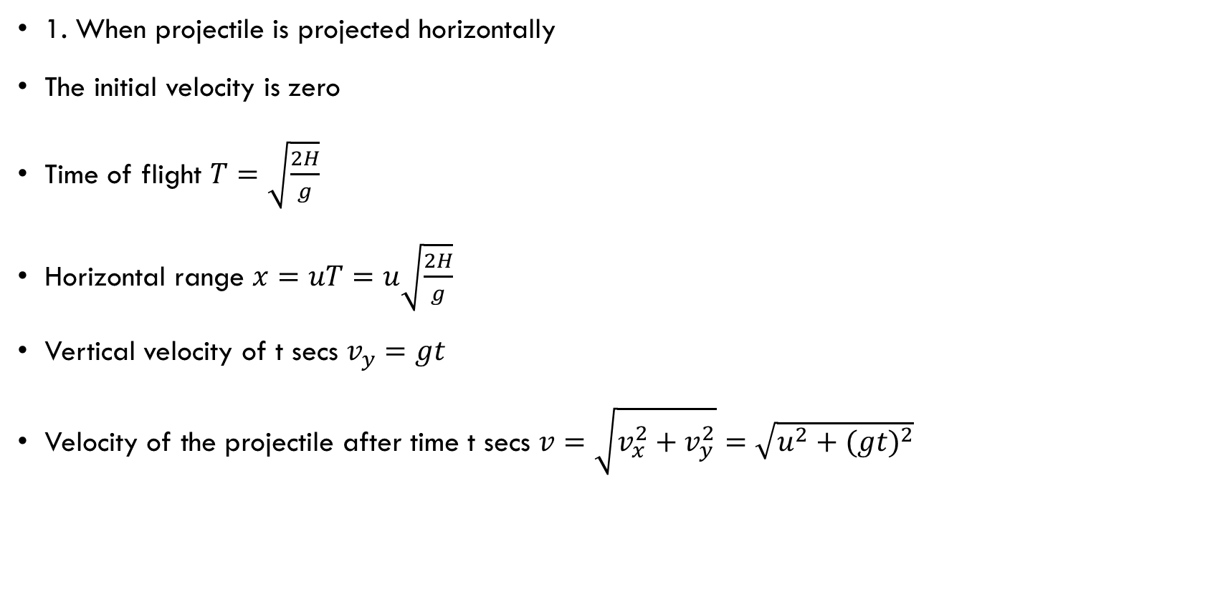
Projectile projected from some height

Slide 51
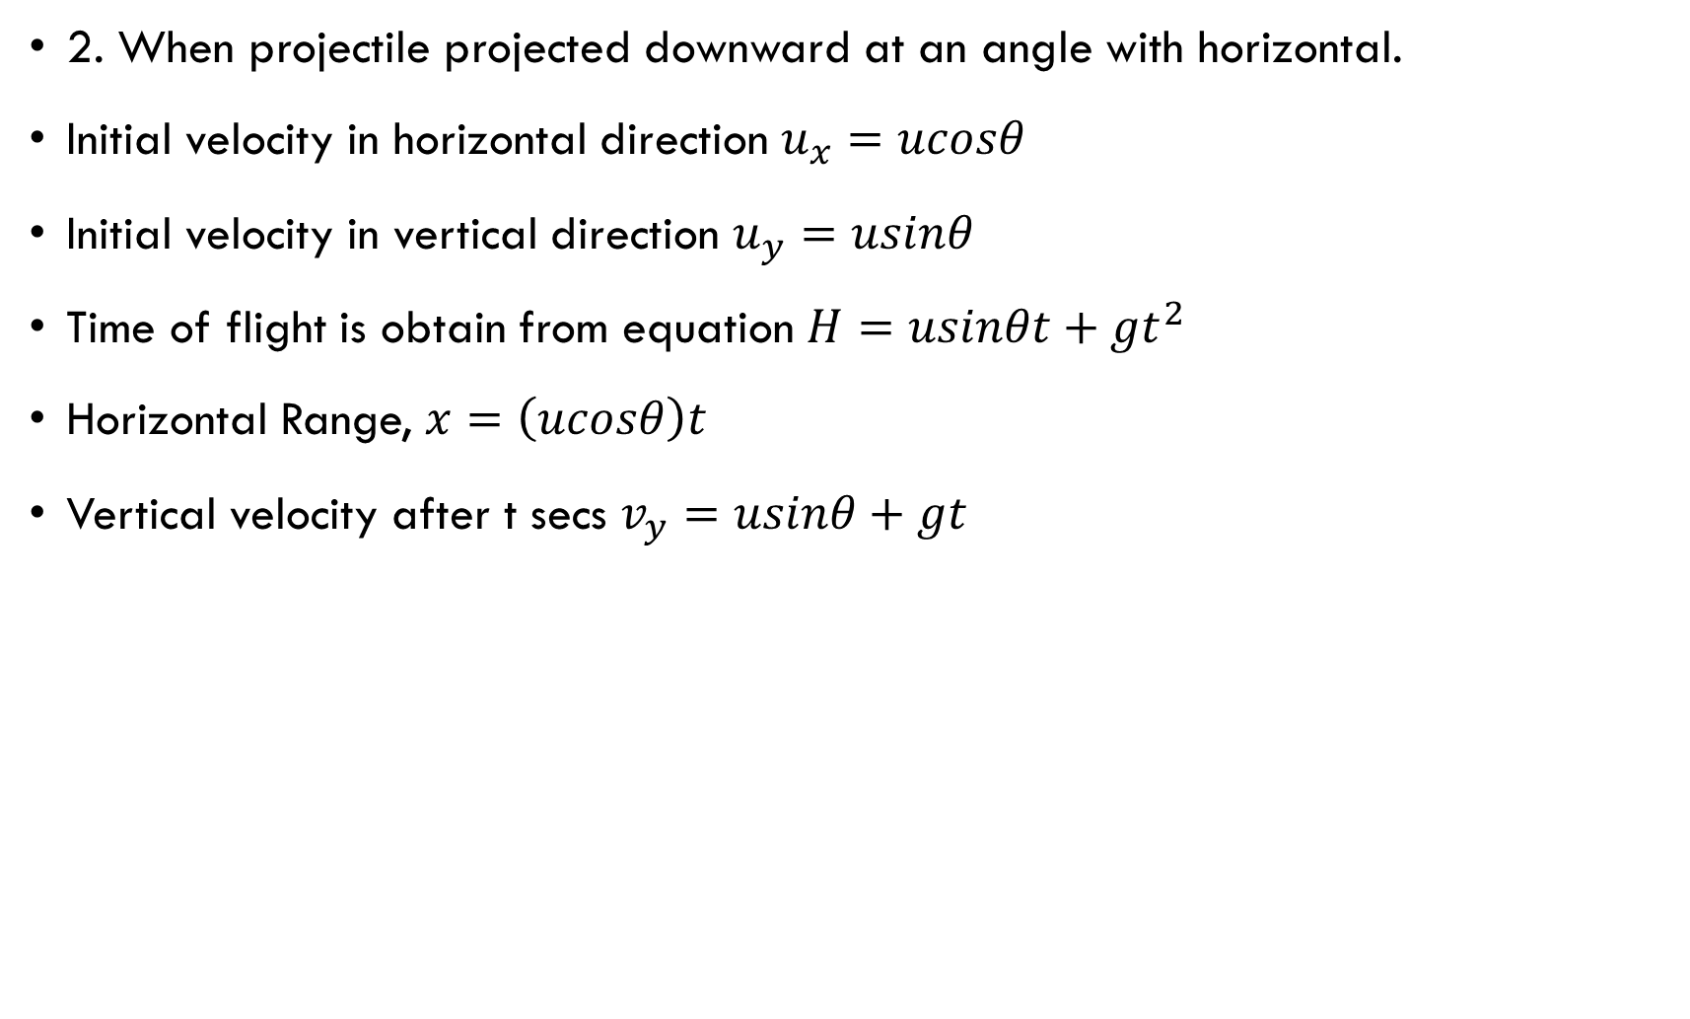

Slide 52
Conservation principle in physics
Conservative force: This is such force for which the work done by this force on a particle moving between any two points is independent of the path taken by the particle.
The work done by a conservative force on a particle moving through any closed path is zero.
Examples of conservative force are:
Gravity
Spring force

Slide 53
Non conservative force: A non conservative force does not satisfy the condition of conservative force.
This force acting in a system causes changes in the mechanical energy of a system.
Examples of non conservative forces are
Friction
Tension

Slide 54
Conservation of linear momentum
Momentum is the product of mass and velocity. Its unit is kgm/s.

